Slide 1
Labour survey of Gatineau Valley companies
Presented to the Gatineau Valley SADC
December 10, 2018

Slide 2

Table of Contents
Highlights 3
1. Objectives 6
2. Methodology 7
3. Respondent profiles 11
4. Job profiles 13
5. Labour issues and challenges 18
6. Labour recruiting 22
7. Labour retention 31
8. Owner succession 33
2

Slide 3
Highlights
Methodology and respondent profiles
The survey was conducted using a combined telephone-online methodology of 306 companies located on the territory served by the Gatineau Valley SADC.
Most of the persons who participated owned the companies surveyed (82%).
Slightly more than half of the owners of the companies surveyed were men (56%), 55 years of age or older (51%), owners for more than 15 years (51%) and have high school or less (52%).
About two-thirds (65%) of the companies surveyed have employees. Companies in the region are active in the following sectors: commerce/accommodation/restauration (28%), primary/transport sector (20%), professional services (17%), other services (17%), secondary sector (14%) and public administration (3%).
Job profiles
The companies surveyed have 14.9 employees on average, i.e., 7.4 full time (50%), 3.9 part time (26%) and 3.6% seasonal (24%). However, one half of them (50%) do not have any part-time employees and 55% have no seasonal employees. The primary/transport sector employs fewer people in total (6.2) than the other sectors.
Part-time employees work 22.3 hours per week on average and seasonal workers 21.2 hours. These proportions have been stable (72%, 73%) or have increased (19%, 17%) in the past 3 years. Almost 50% of seasonal employees are hired in April and May. Almost one-quarter (27%) of seasonal workers have to be replaced each year.
Employees in the region are 54% male and 46% female and are distributed relatively equal in terms of their age: less than 35 (31%) 35-54 (40%), and 55 and over (30%). Almost 2/3 (61%) of employees have less than 10 years’ seniority in the company.
A union is present in only one company out of 10, and 50% of jobs are described as having few or no qualifications, i.e., no diploma or only a general high school diploma is required.
3

Slide 4
Highlights
Labour issues and highlights
In terms of labour, the most important issues facing the companies surveyed are recruiting (81%) and retention (84%) of qualified labour and the integration of employees from the younger generation (less than 35 years of age) (83%).
Succession for executive/managerial positions (74%) and the recruiting of seasonal labour (71%) are also important challenges facing companies in the region.
Most companies are open to hiring people from Indigenous communities (80%) or immigrants (72%).
With respect to human resources in the next few years, the companies surveyed cited the retention of their employees (70%) and recruiting new people (44%) as the main objectives. In addition, one quarter of the companies (25%) believe they will be facing the possibility of having to train their employees.
Recruiting workers
Companies in the region hired 5.5 employees on average in the past year, i.e., 1.6 full time (29%), 1.4 part time (25%) and 2.4 seasonal (44%). Close to half of the companies indicated that recruiting employees has been difficult, particularly due to the lack of labour and applicants. Recruiting is generally done through referrals from people who know somebody or from employees (66%), through the social media (32%), Emploi-Québec (27%) and newspapers (24%).
Companies will have 3.5 positions to fill on average in the coming year, i.e., 1.1 full time (31%) 1.1 part time (31%) and 1.3 seasonal (37%). That said, 32% of the companies that responded do not anticipate having to fill any positions and 56% specifically said they will not have any full-time positions to fill. Slightly more than half of the companies that employ seasonal workers (54%) would be interested in working in cooperation with other employers that hire during different times of the year than them in order to fill seasonal positions.
The lack of workers is perceived as an impediment to growth by more than half of the companies surveyed (53%). The consequences of this situation are many – employees have to work more hours (37%) and the company must turn down contracts or orders (30%). To make up for the shortage, companies in the region have taken numerous measures such as increasing salaries (45%), hiring less qualified workers (43%), younger people (42%) or retirees (39%).
4

Slide 5
Highlights
Retaining workers
Companies resort to a host of practices to retain workers, which mainly includes offering competitive compensation (71%), sharing information transparently (68%) and supporting life-work balance (65%).
In order to help them with their efforts to recruit and retain employees, companies would like to exchange ideas with other entrepreneurs (40%) to find out what they have done about it and draw on their experiences. Obtaining human resources training (32%) and information on new practices in this field (30%) are other needs that were cited.
Succession
Close to one-third of the business owners surveyed (29%) plan on leaving in the next 5 years. Most are older men who have been owners for more than 20 years.
Only 12% of owners are far along in their succession process or have already lined up successors, but the figure is twice that among long-time owners.
Most owners (65%) who planned to leave in the next 2 years and have started thinking about succession claim that they are facing specific issues, particularly financial challenges, not having any successors, finding a buyer, family challenges, etc.
These owners would like to have individual guidance for themselves (41%) or their successors (33%), such as consultation, coaching, mentoring, etc., to support them during the succession planning process.
Many of these owners (72%) claimed that they know the market value of their company. This is based on the market value (76%) or the book value (52%).
5

Slide 6
1. Objectives
The Gatineau Valley SADC retained BIP Research to survey companies in the region. This study is part of the “Chantier relève” (succession worksite) project. The general objective of the survey is to document the situation and the issues facing Gatineau Valley companies in terms of entrepreneurial succession and HR succession. The information gathered will enable SADC and local partners to effectively map out a course of action to address these topics over a timeframe of several years.
The survey covers two major issues confronting companies – recruiting and retention of workers and the succession of business owners.
The section on the recruiting and retention of workers:
  Establishes the profiles of jobs on the territory: the number of employees according to status, the characteristics of seasonal jobs, the breakdown of jobs by gender, age, seniority and level of qualifications, etc.
  Identifies the main labour-related issues and challenges that companies face.
  Delves into the recruiting problems: the number of hires, how readily workers can be hired, recruiting methods used, the number of positions to fill, the consequences of labour shortages for companies and measures taken to address this issue, practices and tools to make recruiting easier.
  Looks more closely at the problem of retaining workers: practices conducive to retention, the companies’ needs so that they can receive support in their efforts to retain workers.
The section on succession of business owners:
  Examines the profiles of business owners.
  Looks at how far along they are in planning their succession.
  Discusses their concerns or specific challenges confronting them.
  Reveals the type of resources they use.
  Identifies the type of coaching they would like to receive with respect to succession planning.
6

Slide 7
2. Methodology
Target population
The target population consists of businesses in the territory served by the Gatineau Valley SADC, which provided BIP Recherche with a data base with the names of 1,181 businesses and their contact information. This figure was arrived at as follows:
1,347 names in the data base initially provided
– 288 that had no telephone
+ 122 numbers that SADC looked for
  In order for a company to be eligible to take part in the survey, staff hiring decisions had to be made locally, i.e., in the establishment that is called.
  Respondents to the survey were ranked in the following order of priority:
  The owner or one of the owners of the business.
  Secondly, the person responsible for human resources or production/operations. In this case, the respondent did not complete the section of the questionnaire dealing with the owner’s succession.
  Questionnaire
  The questionnaire, which was designed jointly by SADC and BIP Recherche, had 90 variables, including 4 open-ended questions.
  Depending on the answers to two introductory questions – whether or not there were employees (full time, part time or seasonal) and whether or not the respondent was the owner – there were four possible scenarios.
Possible scenarios | Paid employees | The respondent was the business owner | Sections of the questionnaire completed
A | Yes | Yes | The entire questionnaire
B | Yes | No | Job profile, labour-related issues and challenges, recruiting, retention
C | No | Yes | Management succession
D | No | No | The company was not eligible to take part in the survey
7

Slide 8
2. Methodology
How we conducted the survey
We used a combined telephone-online methodology. All respondents received a phone call in either English or French. Once the introduction was read and the objectives explained, eligible respondents who agreed to participate could choose to respond over the phone or online.
Those opting to respond on line were sent an invitation email with a link providing access to the survey. Most needed from one to three telephone reminders in the weeks following the invitation email.
Data collection
The survey was pretested with about 10 companies on October 30, 2018. No changes were made to the questionnaire following the pretest. The full survey itself ran from November 1 to 23, 2018. In total, 306 questionnaires were completed – 148 over the phone (48.4%) and 158 online (51.6%). The telephone interviews took 15.7 minutes on average. Our objective at the outset was to have 300 completed questionnaires.
The response rate (35% in this instance) is calculated according to the standards of the Marketing Research and Intelligence Association (MRIA). The administrative report on how the survey was conducted, which included the response rate, appears on the following page.
  The margin of error is 4.8% 19 times out of 20, which takes into account the small sample size.
Data processing
Interviews were compiled using Voxco’s Pronto software and processed using the Stat-XP software.
8

Slide 9
2. Methodology
Survey administrative report
9

Slide 10
2. Methodology
Segmentation variable
We processed and analyzed the findings based on several segmentation variables, which enabled us to perform a bivariate statistical analysis, i.e., the production of cross-referenced tables of dependent variables with independent (or segmentation) variables. This cross-analysis revealed whether there were any statistically significant differences per respondent group. If necessary, we indicated the most significant differences in the report.
 | Sections : Job profiles, issues and challenges with respect to labour, recruiting and retention | Section : Owner succession
Segmentation variables | NAICS area of activity | NAICS area of activity
 | Total number of employees: small business (less than 5); medium-sized business (5 to 14); large company (15 and over) | Total number of employees (less than 5; 5 to 14; 15 and over)
 | Percentage of employees 55 and over (0%, 1% to 49%); 50% and over) | Owner’s gender (man, woman)
 | Percentage of jobs that have few or no qualifications (0%, 1% to 49%; 50% and over) | Owner’s age (<45, 45-54, 55-64; 65 and over)
 | Total number of vacancies to be filled at present (0; 1 or 2; 3 and over) | Owner’s education (secondary school or less; college; university
 | Union present (yes or no) | Number of years as owner (<5 years, 5-9 years; 10-19 years; 20 years and over)
Notes
In the following chapters, the data expressed as a percentage have been rounded off with no decimals to make the figures and the tables less cumbersome. As a result, some totals may come to 99% or 101%.
All of the cross-referenced tables, which show both the frequencies and the results of the bivariate statistical treatments, are in a document separate from this report.
In the cross-reference tables, we took into account the significant differences in proportions when the difference achieved a confidence level of:
  99.9% and over, i.e., 4 plus (++++) and 4 minus (----);
  99% and over. i.e., 3 plus (+++) and 3 minus (---);
  95% and over, i.e., 2 plus (++) and 2 minus (--).
10

Slide 11
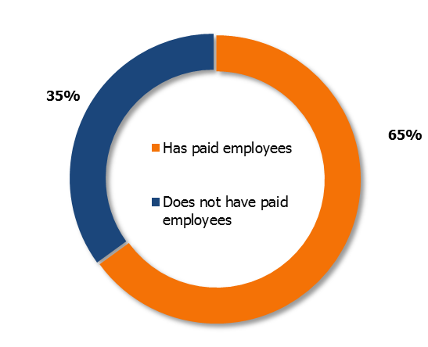
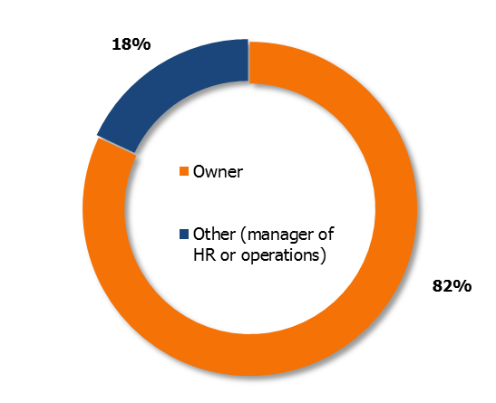
3. Respondent profiles
Figure 1 – Presence of paid employees (n=306)
Major statistically significant variances*
Other services 52% +
Commerce/accommodation/restauration 75% +
In the vast majority of cases (82%), we questioned the business owner.
Figure 2 – Respondent’s position (n=306)
Two-thirds of the companies surveyed have paid employees. This is more often the case with companies active in the commerce/ accommodation/restaurant sector.
* All of the boxes relating to the figures in this report have statistically significant variances.
11

Slide 12
3. Respondent profiles
Table 1 – Area of activity of surveyed companies (n=306)
Table 2 – Company location (n=306)
NCIAS code | Name | Number |  | Grouping | %
11 | Agriculture, forestry, fishing and hunting | 41 |  | Primary sector, transport | 20%
48-49 | Transport & storage | 21
23 | Construction | 35 |  | Secondary sector | 14%
31-33 | Manufacturing | 9
Tertiary sector
41 | Wholesaling |  | 4 | Commerce, accommodation and restauration | 28%
44-45 | Retailing |  | 55
72 | Accommodation and restauration services |  | 26
51 | Information industry and cultural industry |  | 1 | Professional services | 17%
52 | Finance and insurance |  | 6
53 | Real estate and leasing services |  | 4
54 | Professional, scientific and technical services |  | 13
56 | Administrative services, support services, waste management services and sanitation services |  | 3
61 | Teaching services |  | 2
62 | Health care and social assistance |  | 16
71 | Arts, entertainment and leisure |  | 8
81 | Other services (except public administration) |  | 52 | Other services | 17%
91 | Public administration |  | 10 | Public administration | 3%
City/town | %
Aumond | 2%
Blue Sea | 3%
Bois-Franc | 1%
Bouchette | 6%
Déléage | 8%
Denholm | 1%
Egan Sud | 4%
Gracefield | 12%
Grand-Remous | 9%
Kazabazua | 3%
Kitigan Zibi (Indigenous territory) | 2%
Lac Cayamant | 2%
Lac Sainte-Marie | 4%
Low | 3%
Maniwaki | 32%
Messines | 5%
Montcerf-Lytton | 4%
Sainte-Thérèse-de-la-Gatineau | 2%
12

Slide 13
4. Job profiles
Number of employees
Table 3 – Number of employees (n=198)
The 198 respondents that have paid employees (table 3) have 14.9* employees on average: 7.4 full time (50%), 3.9 part time (26%) and 3.6 seasonal (24%)
This average is inflated by a few extreme values, including a health care institution that has 577 employees. If the two highest numbers are excluded, the average drops to 11.1 employees per company.
Half the companies (50%) do not have any part-time employees, and 55% do not have any seasonal employees (table 3a).
In total, the respondents have 2,950 employees, which includes 1,465 full-timers (table 3a)
The primary and transport sectors have fewer full-time jobs than the average company.
Job status | Average number of jobs | Major statistically significant variances |  | Average without extreme values
Full time | 7.4 | Large companies 1-49% employees 55 yrs+ 1-49% empl. little/ho qual. 3+ positions to fill Union: yes Primary/transp. sector | 20.2 + 13.0 + 15.8 + 14.4 + 20.6 + 2.3 - | 6,2
Part time | 3.9 |  |  | 2.1
Seasonal | 3.6 | Large companies 3+ positions to fill 50%+ employees 55 yrs + 0% empl. little/no qual. | 12.4 + 9.3 + 1.1 - 0.9 - | 2.7
Total | 14.9* | 1-49% employees 55 yrs+ 3+ positions to fill Primary/transp. sector 0% empl. little/no qual. | 25.5 + 35.6 + 6.2 - 4.4 - | 11.1
Calculations of averages include the zeros.
Table 3a – Respondent breakdown according to job status (n=198)
Job status No. of employees | Full time | Part tiime | Seasonal | Total jobs
0 | 10% | 50% | 55% | 0%
1 to 4 | 49% | 37% | 31% | 37%
5 to 14 | 29% | 10% | 8% | 39%
15 and over | 12% | 3% | 6% | 24%
Total number of employees
 | 1 465 | 772 | 713 | 2 950
* In 2015, a study entitled a Gatineau Valley Company Characterization Study by Zins Beauchesne and associates showed that companies had 7.2 workers on average. The difference between the data in that study and this one is due to the fact that the sampling (eligibility criteria) was totally different, as were the objectives.
13

Slide 14
4. Job profiles
Part-time employees
Seasonal employees
Table 4 – Number of hours worked by part-time employees (n=99)
Table 5 – Duration of seasonal employee jobs (n=90)
Table 6 – Months when seasonal employees hired (n=90)
Number of hours | %
1 to 15 | 32%
16 to 25 | 33%
More than 25 | 39%
Average number of hours | 22.3
Number of weeks | %
1 to 15 | 29%
16 to 25 | 42%
More than 25 | 29%
Average number of weeks | 21.2
Months | %
January | 6%
February | 4%
March | 9%
April | 22%
May | 27%
June | 10%
July | 7%
August | 1%
September | 2%
October | 3%
November | 7%
December | 2%
In the past 3 years, this average has been: | %
Increasing | 19%
Stable | 73%
Decreasing | 8%
In the past 3 years, this number has been: | %
Increasing | 17%
Stable | 72%
Decreasing | 11%
Table 7 – Proportion of seasonal employees to be replaced annually in the past 3 years (n=90)
Part-time employees work 22.3 hours a week (Table 4), a figure that has remained stable for 3 years.
0% | 38%
1% to 25% | 24%
26% to 50% | 21%
More than 50% | 17%
Average percentage | 27.3%
These figures peak in April and May (almost 50%) and bottom out in August and September (only 3%) (Table 6).
Seasonal employees work 21.2 weeks per year (Table 5), a figure that has remained stable for the past three years. Slightly more than one-quarter (27%) of seasonal workers have to be replaced each year (Table 7).
14

Slide 15
4. Job profiles
Employee breakdown by gender
Employee breakdown by age
Table 8 – Employee breakdown by gender (n=198)
Table 9 – Employee breakdown by age (n=198)
Gender | Average breakdown | Major statistically significant variances
Men | 54.3% | Primary/transp. sector Secondary sector Other services 1-49% employees 55 yrs+ | 71.3% + 81.5% + 64.4% + 60.9% +
Women | 45.7% | Professional services 1-49% employees 55 yrs+ | 73.2% + 39.1% -
Age | Average breakdown | Major statistically significant variances
Less than 25 | 11.7% | Professional services | 19.6% +
25-34 | 18.9% | 0 vacancies | 13.3% -
35-54 | 39.9% | Large companies | 49.7% +
55 and over | 29.5% | Small companies 0 vacancies 1-49 little/no qualifications | 36.8% + 41.3% + 20.8% -
Table 8a – Respondent breakdown by gender (n=198)
Gender % of employees | Women | Men
0% to 9% | 21% | 18%
10% to 49% | 30% | 21%
50% to 89% | 29% | 37%
90% to 100% | 20% | 24%
Table 9a – Respondent breakdown by age per age segment (by proportion) (n=198)
Age % of employees | Gender than 25 | 25-34 | 35-54 | 55 and over
0% | 54% | 41% | 17% | 26%
1% to 49% | 37% | 45% | 43% | 43%
50% and over | 9% | 13% | 40% | 31%
The employees of the 198 respondents are 54% male and 46% female (Table 8).
There are more male employees in the primary/transport, secondary and other services sectors (Table 8).
More than two-thirds of employees of respondents are over 35. Those 55 and over represent close to a third (Table 9).
More than one half of companies (54%) have no employees under 25 (Table 9a). At least one half of employees are 55 and over in close to one third (31%) of the companies. This illustrates that the workforce is aging.
15

Slide 16
4. Job profiles
Employee distribution by seniority
Breakdown of employees by job qualification level
Table 10 – Employee distribution by seniority (n=198)
Table 11 – Breakdown of employees by job qualification level (n=198)
Seniority | Average breakdown | Major statistically significant variances
Less than 5 years | 39.6% | No employees 55 and over | 62.1% +
5-9 years | 21.2%
10-14 years | 13.2% | Large companies 1-49% employees 55 and over 1-49 employees little/no qual. 3+ positions to fill | 21.3% + 19.5% + 20.7% + 19.5% +
15 and over | 26.0% | 50%+ employees 55 and over No positions to fill | 38.8% + 33.0% +
Qualification level | Average distribution | Major statistically significant variances
Very qualified | 13%
Qualified or semi-qualified jobs | 37% | Commerce/accommodation/restauration | 28.9% +
Low or non-qualified jobs | 50% | Commerce/accommodation/restauration | 61% +
Table 11a – Respondent breakdown by job skills by qualification category (by proportion) (n=198)
Table 10a – Respondent breakdown by seniority and by seniority category (by proportion) (n=198)
Qualification level % of employees | Very qualified jobs | Qualified or semi-qualified jobs | Little or no qualifiications
0% | 61% | 33% | 24%
1% to 49% | 27% | 26% | 23%
50% and over | 12% | 40% | 54%
Seniority % of employees | Less than 5 years | 5-9 years | 10 to 14 years | 15 years and over
0% | 17% | 40% | 56% | 40%
1% to 49% | 46% | 44% | 33% | 34%
50% and over | 37% | 16% | 11% | 26%
Four employees in 10 have fewer than 5 years’ seniority while more than a quarter have more than 15 years (Table 10).
In 37% of companies, at least half of the employees have 5 years’ seniority. 40% of companies do not have any employees with 15 years of seniority and over.(Table 10a).
One-half of employees in the companies surveyed hold jobs requiring few or no qualifications, i.e., no diploma or just a general high school diploma. Very qualified jobs that require university training only account for 13% of the total jobs in the region (Table 11).
61% of respondents do not have any very qualified jobs (Table 11a).
16

Slide 17
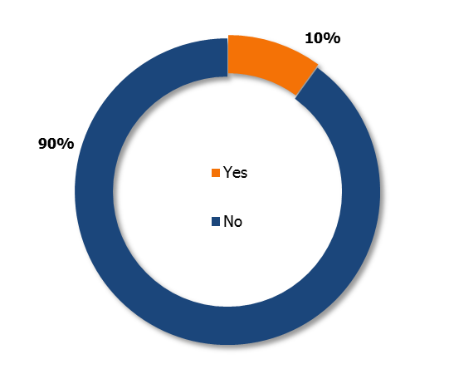
4. Job profiles
Unionization
Figure 3 – Presence of a union in the company (n=198)
Large companies 26% +
1-49% jobs little/no qual. 18% +
3+ positions to fill 22% +
1-49% employees 55 yrs+ 19% +
Commerce/accomm./restau 97% +
Medium-sized businesses 96% +
0% employees 55 yrs+ 98% +
1-2 positions to fill 97% +
50%+ employees 55 yrs+ 97% +
Only one in ten companies taking part in the survey is unionized. More than one-quarter of companies in the region with more than 15 employees are unionized.
17

Slide 18
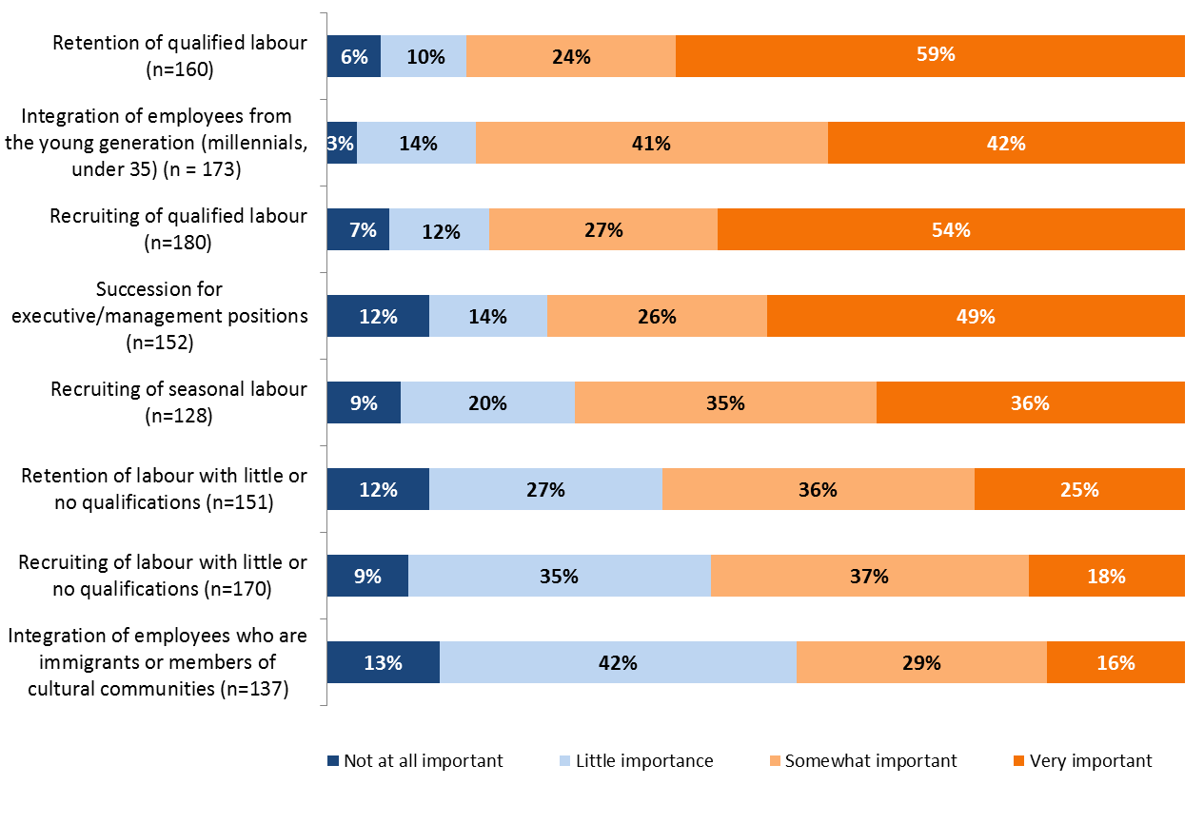
5. Labour issues and challenges
Figure 4 – Importance of some labour issues (n=198)
% of don’t know and N/A
19%
13%
9%
23%
35%
24%
14%
31%
Excludes the Don’t know and the Not applicable.
18

Slide 19
5. Labour issues and challenges
Table 12 – Importance of some issues – major statistically significant variances
Issues | % very and rather important | Major statistically significant variances
Retention of qualified labour (n=160) | 84% | Small companies 50%+ empl. little/no qualif. | 74% - 76% -
Integration of employees from the young generation (millennials, younger than 35) (n=173) | 83% | Large companies | 94% +
Recruiting of qualified labour (n=180) | 81% | 0% empl. ilttle/no qualif. 1-49% empl. little/no qualif. | 93% + 96% +
Succession for executive/management positions (n=152) | 74% | Small companies 50%+ empl. little/no qualif. | 61% - 64% -
Recruiting of seasonal staff (n=128) | 71%
Retention of labour with little or no qualifications (n=151) | 61% | Commerce/accomm./restaur 1-49% employees 55 yrs+ 3+ positions to fill Small businesses | 71% + 69% + 80% + 39% -
Recruiting of labour with little or no qualifications (n=170) | 55% | 0% empl. ilttle/no qualif | 38% -
Integration of employees who are immigrants or from cultural communities (n=137) | 45% | 0% empl. ilttle/no qualif | 61% +
The three most important issues for companies in the region are retention (84%) and recruiting (81%) of qualified labour, and the integration of employees 35 and under (83%) (Table 12).
This is followed by concerns about company management succession (74% and the recruiting of seasonal employees (71%).
The issues of integrating employees from cultural communities or those with few or no qualifications are of less concern to the companies surveyed.
According to the companies, recruiting for seasonal jobs is difficult due to the general lack of labour and the very nature of those types of jobs, i.e., short term, unstable, few hours offered and a modest salary (Table 13).
Table 13 – Reasons why recruiting seasonal workers is difficult (n=91)
Reasons | %
Lack of labour/lack of qualified labour | 22%
Job or short duration/not long enough to get employment insurance | 15%
Full-time job preferred/not enough hours | 13%
Pay not high enough | 9%
Seasonal job/not year round/not stable | 7%
Jobs mostly for young people or retirees/lack of young people | 7%
Demanding jobs/very physical | 6%
 | %
Distance / remote retion | 6%
Standards to follow/restrictive policies/government measures | 6%
It is full employment/already have a job | 3%
Competition with other regions/cities/towns | 2%
People don’t want to work | 2%
People want to be paid under the table/in cash | 2%
Do not know/refused to answer | 28%
19

Slide 20
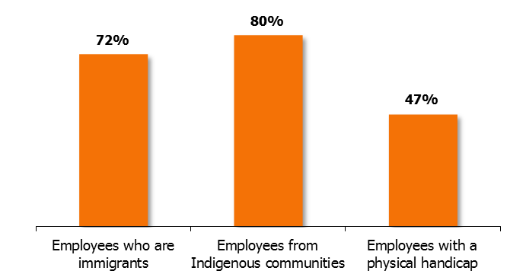
5. Labour issues and challenges
Figure 5 – Openness to hiring certain categories of employees (n=198)
Small companies 62% -
Medium-sized companies 90% +
50%+ empl. little/no qual. 75% -
Large companies 62% +
1-49% empl. little/no qual. 69% +
0 positions to fill 37% -
Respondents with paid employees are open to hiring employees from Indigenous communities (80%) or immigrants (72%). However, less than half are willing to take on employees with a physical handicap (47%).
20

Slide 21
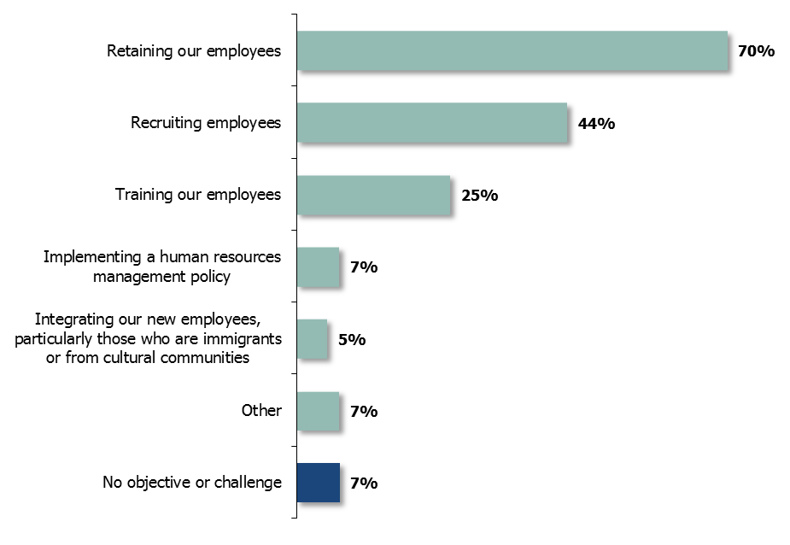
5. Labour issues and challenges
Figure 6 – Principal human resources objectives and challenges for the next three years (n=198)
Large companies 60% +
1-49% empl. 55 years+ 55% +
1-49% empl. few/no qual. 62% +
Commerce/accom/restaur 16% -
Small companies 10% -
Medium-sized companies 35% +
The companies surveyed believe that, in the coming years, retaining employees will be their biggest human resources issue (70%), followed by recruiting (44%) and training (25%).
Employee training will be an important issue for a quarter of the companies in the region.
21

Slide 22
6. Recruiting
Number of employees hired
Respondent companies hired an average of 5.5 employees in the past year, as follows: 1.6 full time (29%), 1.4 part time (25%) and 2.4 seasonal (44%) (Table 14).
This average is inflated by a few extreme values, including three companies in the construction, accommodation and other services sectors which hired more than 80 seasonal employees in 2018. When the highest values are eliminated, the average number of employees hired falls to 4.0.
Respondents hired a total of 1,077 employees in the past year. It must be noted that this does not necessarily mean that 1,077 new jobs were created in the region. In fact, some of these jobs involve, for example, replacing employees who have retired or poaching seasonal workers from competitors, etc.
Table 14 – Number of employees hired in the past year (n=198)
Job status | Average number of hires | Major statistically significant variances |  | Average without the extreme values
Full time | 1.6 | Primary/transp. sector Large companies 1-49% employees 55 yrs + 3+ vacancies to fill | 0.6 - 3.7 + 2.7 + 3.3 + | 1.6
Part time | 1.4 | Large companies 3+ vacancies to fill 50%+ employees 55 yrs + 0% jobs. little/no qual. | 3.9 + 4.0 + 0.3 - 0.6 - | 1.2
Seasonal | 2.4 | Medium-sized businesses 0% jobs little/no qual. 1-2 positions to fill 1-49% of employees 55 yrs+ | 0.4 - 0.4 - 0.5 - 5.0 + | 1.0
Total | 5.5 | Primary/transp. sector 0% jobs. little/no qual. Large companies 1-49% employees 55 yrs+ 3+ vacancies to fill | 2.8 - 2.9 - 12.0 + 9.9 + 11.3 + | 4.0
Table 14a – Breakdown of the number of employees hired
according to job status (n=198)
Job status No. hired | Full time | Part time | Seasonal | Total jobs
0 | 50% | 59% | 62% | 16%
1 to 4 | 40% | 33% | 30% | 62%
5 to 14 | 6% | 5% | 3% | 13%
15 and over | 2% | 2% | 3% | 7%
Total number of hires
 | 317 | 277 | 483 | 1 077
Calculations of averages include the zeros.
16% of respondents did not hire any employees and 7% hired 15 or more (Table 14a).
22

Slide 23
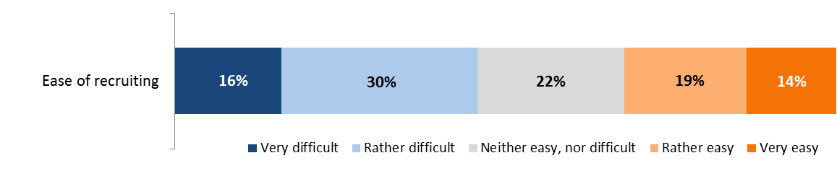
6. Recruiting
Figure 7 – Ease with which employees were recruited in the past year (n=162)
0 positions to fill 32% -
Small companies 48% +
0 positions to fill 48% +
46%
32%
Almost half of the companies that hired employees in the past year found it difficult to recruit them.
Table 15 – Reasons for which recruiting the employees that were hired was difficult (n=74)
Table 16 – Reasons for which recruiting the employees that were hired was easy (n=52)
Reasons | %
Lack of labour/qualified labour | 38%
Lack of application/people don’t want to work/lack of applications | 19%
Few hours offered/seasonal work/not permanent/ part time | 10%
Distance/too far | 8%
Due to CCQ regulations | 4%
Difficult physical conditions | 3%
Employees looking to work under the table | 3%
Low/basic salary offered | 3%
Other | 5%
Did not know/refused to answer | 19%
Reasons | %
Candidate was a friend/relative | 23%
Former employee | 15%
Reputable employer/people want to work there/spontaneous applications | 12%
Recommendations/references | 10%
Several applications | 8%
Competent candidates | 8%
Other | 10%
Did not know/refused to answer | 17%
23

Slide 24
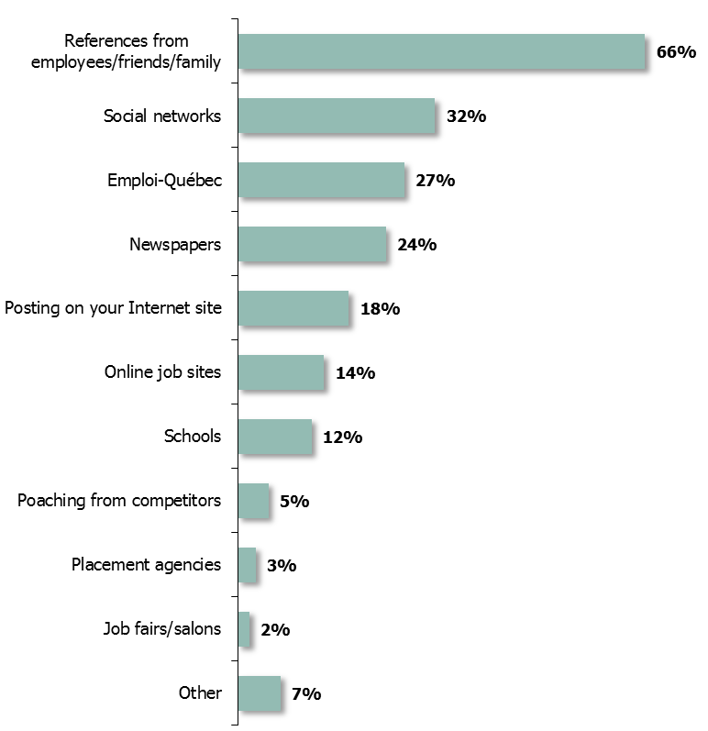
6. Recruiting
Figure 8 – Recruiting methods (n=198)
1-49% empl. 55 years+ 58% -
1-49% empl. few/no qual. 49% -
Large companies 49% +
3+ positions to fill 46% +
50%+ empl. 55 years+ 20% -
Large companies 36% +
50%+ empl. 55 years+ 35% +
1-49% empl. few/no qual. 38% +
Referrals from employees or others was the most common way for companies to hire employees (66%).
This was followed by social media (32%), Emploi-Québec (27%) and newspapers (24%).
24

Slide 25
6. Recruiting
Number of positions to fill
Table 17 – Number of positions to fill in the coming year (n=198)
Job status | Average number of hires | Major statistically significant variances |  | Average without the extreme values
Full time | 1.1 | Primary/transp. sector 0% empl. little/not qual. Large companies 1-49% employees 55 yrs+ | 0.4 - 0.5 - 2.7 + 1.7 + | 1.0
Part time | 1.1 | Primary/transp. sector Secondary sector Small companies 50%+ employees 55 yrs + 0% empl. little/not qual. | 0.2 - 0.2 - 0.2 - 0.2 - 0.3 - | 0.8
Seasonal | 1.3 |  |  | 0.8
Total | 3.5 | Primary/transp. sector 0% empl. little/no qual. Large companies 1-49% employees 55 yrs + | 1.4 - 1.1 - 9.8 + 5.8 + | 2.5
In the coming year, respondents will have to fill an average of 3.5 positions, as follows: 1.1 full time (31%), 1.1 part time (31%) and 1.3 seasonal (37%) (Table 17).
This average is inflated by a few extreme values, including one health facility and one hotel that have approximately 100 positions to fill. When the highest values are eliminated, the average falls to 2.5 positions to fill.
Table 17a – Breakdown of the number of positions to fill in the coming year by job status (n=198)
Calculations of averages include the zeros.
Job status No. of positions to fill | Full time | Part time | Seasonal | Total jobs
0 | 56% | 69% | 65% | 32%
1 to 4 | 36% | 25% | 27% | 52%
5 to 14 | 5% | 1% | 3% | 11%
15 and over | 1% | 2% | 2% | 3%
Total number of positions to fill
 | 218 | 137 | 168 | 693
Respondents have a total of 693 positions to fill. Large companies have the greatest number of positions to fill, while companies in the primary/transport sector have the fewest (Table 17a).
32% of respondents have no positions to fill and 56% have no full-time positions to fill.
25

Slide 26
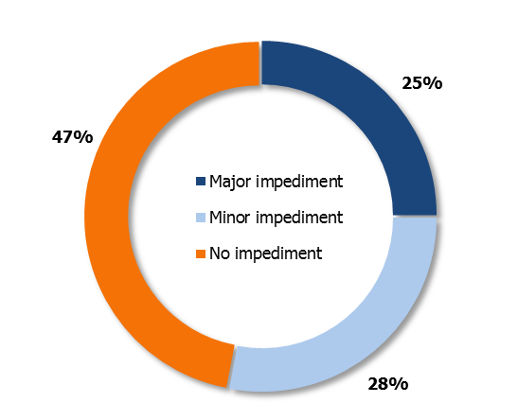
6. Recruiting
Figure 9 – Impact of the labour shortage on the growth of companies (n=198)
Small companies 62% +
50%+ empl. 55 years+ 61% +
0 positions to fill 70% +
3+ positions to fill 41% +
Large companies 43% +
Over half of respondents (53%) believe that the labour shortage represents a major (25%) or a minor (28%) obstacle to the growth of their company. The labour shortage has less of an impact on the growth of very small companies or on that of those with a large pool of older employees.
26

Slide 27
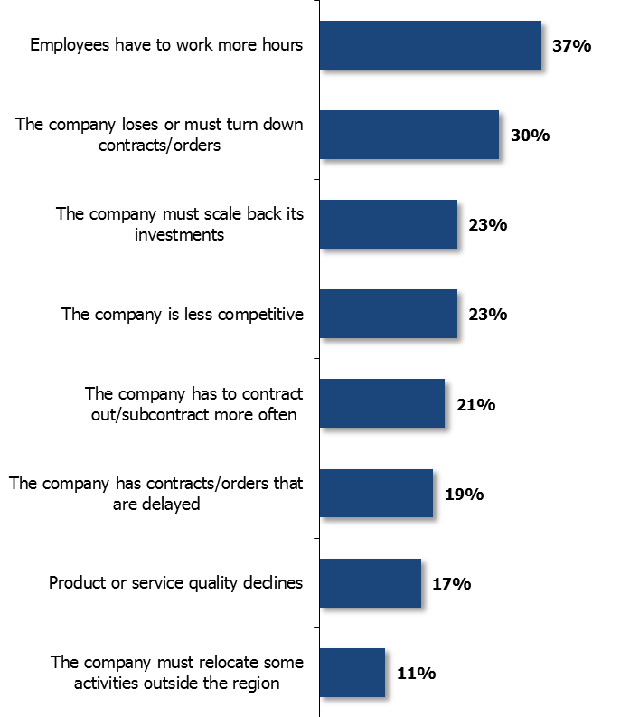
6. Recruiting
Figure 10 – Consequences of the labour shortage on the growth of companies (n=198)
1-49% empl. 55 years+ 47% +
3+ positions to fill 52% +
1-2 positions to fill 41% +
50%+ empl. few/no qual. 22% -
50%+ empl. 55 years+ 18% -
Commerce/accom/restaur 14% -
Small companies 15% -
The consequences of the labour shortage affect companies in several ways. In particular, employees must work more hours (37%) and the company either loses or must refuse contracts (30%).
The other consequences are as follows: fewer investments (23%), contracting out (21%), delayed orders (19%) and deliverables of lesser quality (17 %).
27

Slide 28
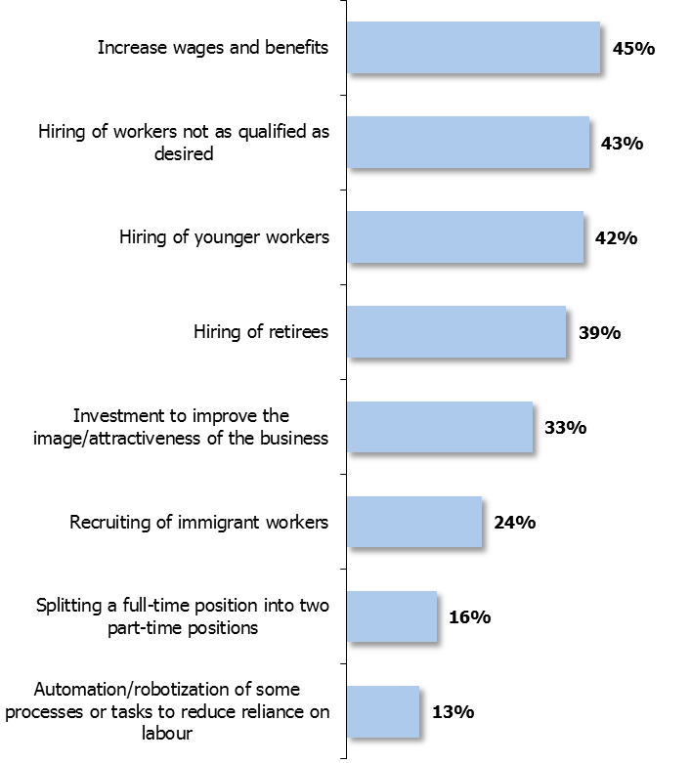
6. Recruiting
Figure 11 – Measures that companies must take in the context of a labour shortage (n=198)
Medium companies 56% +
1-49% empl. few/no qual. 60% +
1-2 positions to fill 57% +
3+ positions to fill 57% +
Large companies 62% +
1-49% empl. 55 years+ 52% +
1-2 positions to fill 54% +
Professional services 23% -
Large companies 55% +
1-49% empl. 55 years+ 51% +
3+ positions to fill 56% +
Large companies 53% +
1-49% empl. 55 years+ 47% +
3+ positions to fill 54% +
Respondents acknowledge having to take various measures to mitigate the impact of the labour shortage, mainly increasing salaries (45%) and hiring employees who are either less qualified (43%) or younger (42%) than they would like, or retired (39%).
A third of respondents say they invest in improving their employer brand to attract candidates.
28

Slide 29
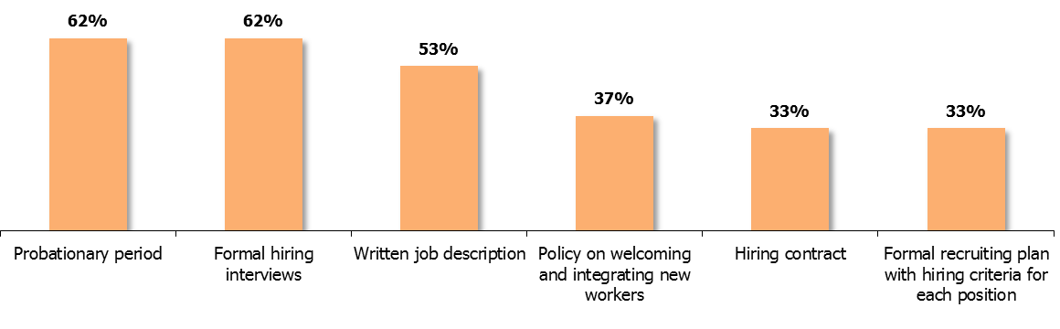
6. Recruiting
Figure 12 – Use of the following recruiting tools or practices (n=198)
Primary/transp. sector 39% -
Large companies 85% +
1-49% empl. 55 years+ 77% +
1-49% empl. few/no qual. 87% +
3+ positions to fill 80% +
Large companies 58% +
1-49% empl. few/no qual. 67% +
3+ positions to fill 48% +
Primary/transp. sector 46% -
Large companies 83% +
1-49% empl. 55 years+ 73% +
1-49% empl. few/no qual. 80% +
Large companies 49% +
1-49% empl. few/no qual. 58% +
3+ positions to fill 46% +
Professional services 74% +
Large companies 79% +
1-49% empl. few/no qual. 76% +
3+ positions to fill 67% +
Professional services 52% +
Large companies 53% +
1-49% empl. few/no qual. 62% +
3+ positions to fill 44% +
Over half of the region’s companies adopt the following recruiting practices: a probation period (62%), formal interviews (62%) and written job descriptions (53%).
However, only one third of companies have a policy in place for welcoming and integrating new workers (37%), a hiring contract (33%) or a formal recruiting plan (33%).
A greater number of larger companies (15 employees or more) or of companies where between 1% and 49% of employees have few or no qualifications use all these recruiting tools.
29

Slide 30
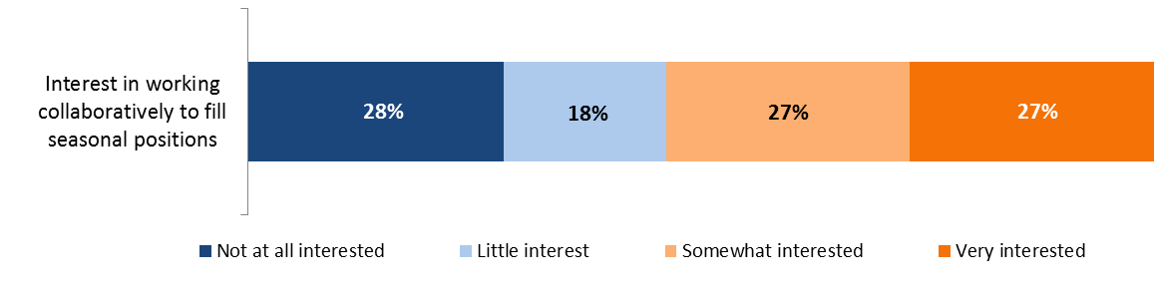
6. Recruiting
Figure 13 – Interest in cooperating with employers who have different hiring seasons to fill seasonal positions (n=90)
46%
54%
% of don’t know and non-applicable
13%
Excludes Don’t know and Non applicable responses.
Over half the companies that hire seasonal workers (54%) would be interested in cooperating with other companies that have different hiring seasons to fill seasonal positions.
30

Slide 31
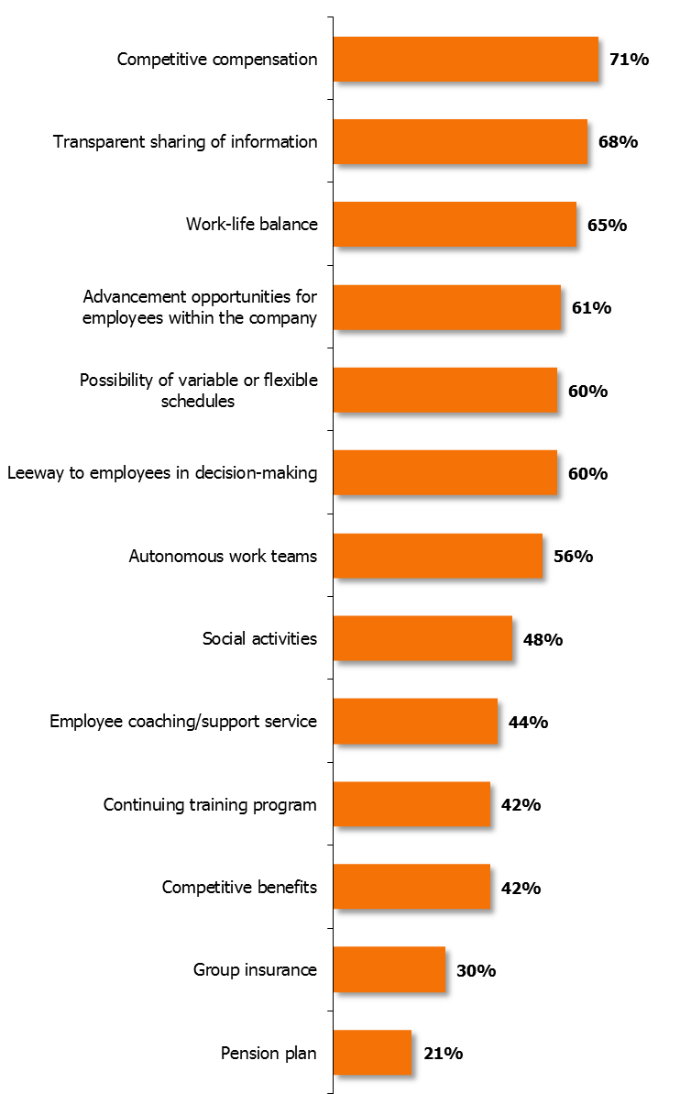
7. Retaining workers
Figure 14 – Practices to help retain workers (n=198)
Commerce/accom/restaur 58% -
Medium companies 82% +
Large companies 83% +
1-49% empl. few/no qual. 91% +
The main strategies used to help retain employees are competitive compensation (71%), sharing information transparently (68%) and supporting life-work balance (65%).
Companies also count on helping employees progress (61%), offering flexible schedules (60%) and giving leeway in decision-making (60%).
The larger the company, the more advantages it offers: training, good compensation, benefits, social activities, etc.
Medium companies 77% +
1-49% empl. 55 years+ 75% +
1-49% empl. few/no qual. 76% +
3+ positions to fill 78% +
Social activities
Continuing education program
Competitive benefits
Large companies +
1-49% empl. 55 years+ +
0% empl. few/no qual. +
3+ positions to fill +
31

Slide 32
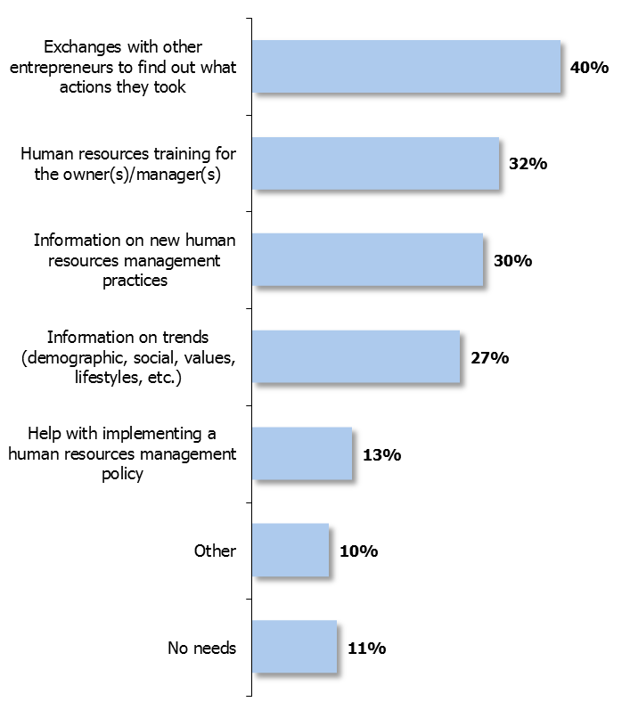
7. Retaining workers
Figure 15 – Support needed by companies to help recruit and retain workers (n=198)
Primary sector/transp. 58% +
Medium companies 52% +
In order to help them in their efforts to recruit and retain employees, companies would like to exchange ideas with other entrepreneurs (40%) to find out what they have done about it.
Other needs cited were obtaining human resources training (32%), and information on new practices in this field (30%) and on general trends (27%).
Small companies 22% -
1-49% empl. 55 years+ 40% +
3+ positions to fill 44% +
Large companies 51% +
1-49% empl. 55 years+ 38% +
3+ positions to fill 43% +
Professional services 44% +
1-49% empl. few/no qual. 42% +
32

Slide 33
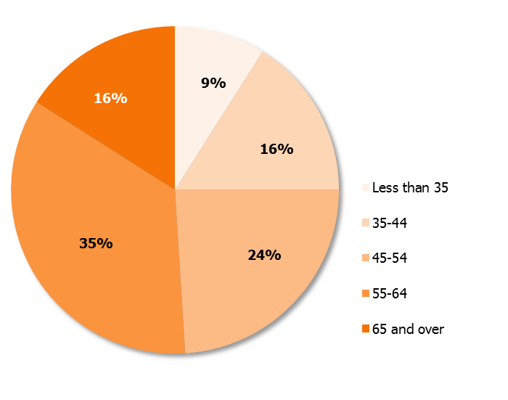
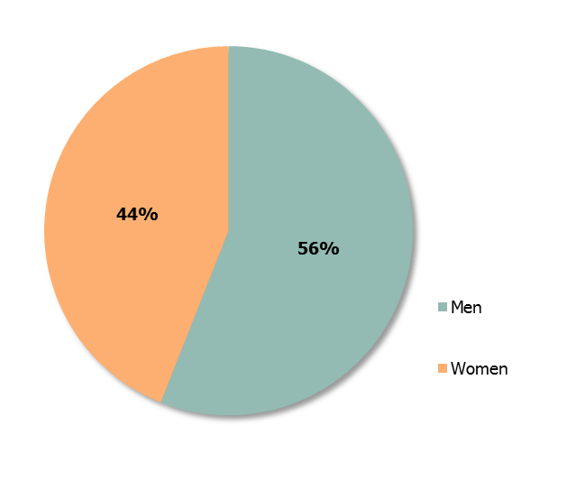
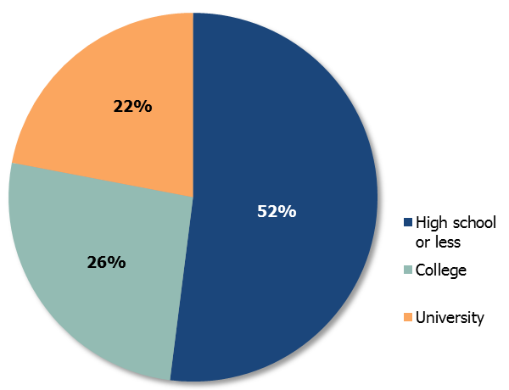
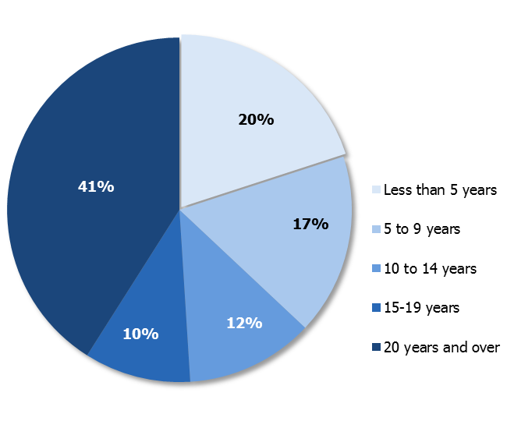
8. Owner succession
  Respondent profiles (n=250)
Figure 17 – Age of owners
Approximately half of respondents were men (56%), 55 years of age or older (51%), owners for more than 15 years (51%) and had high school or less (52%).
Figure 16 – Gender of owners
Figure 18 – Education level of owners
Figure 19 – Number of years of ownership
33

Slide 34
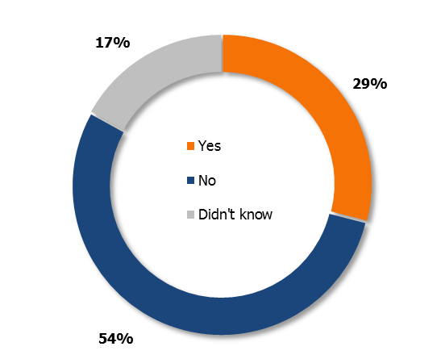
8. Owner succession
Figure 20 – Plan to leave their position as owner in the next five years (n=250)
Men 36% +
55-64 years 43% +
65+ years 62% +
Owner for 20+ years 43% +
Slightly fewer than one-third of owners plan on leaving in the next five years.
Those who plan on leaving are mostly older men (65 years of age or older), who have been owners for more than 20 years.
Women 62% +
˂45 years 82% +
45-54 years 72% +
Owner ˂5 years 84% +
34

Slide 35
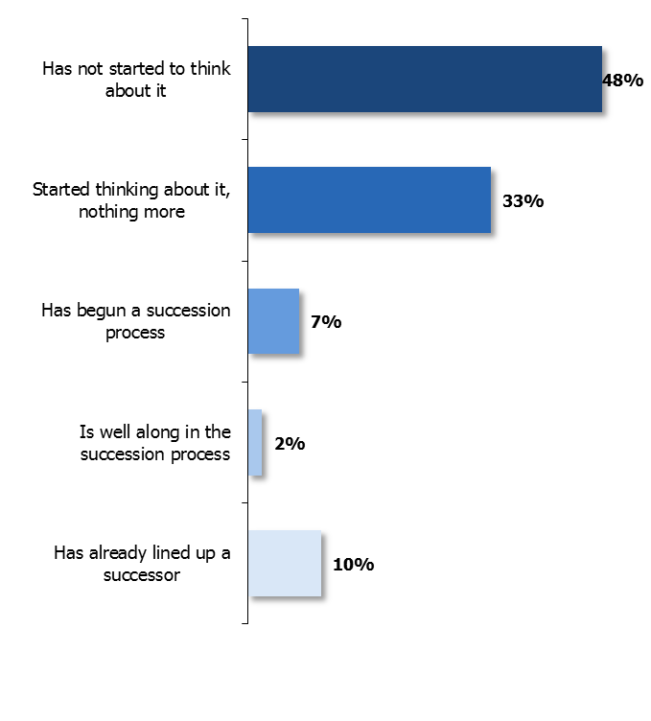
8. Owner succession
Figure 21 – Stages of succession planning (n=250)
Women 60% +
˂45 years 74% +
High school or - 54% +
Owner ˂5 years 71% +
Owner 5-9 years 63% +
Planning on leaving the company
as an owner within 5 years 36% -
Owner for 20+ years 45% +
Planning on leaving the company
as an owner within 5 years 32% =
Owner for 20+ years 12% +
Planning on leaving the company
as an owner within 5 years 15% +
Men 16% +
˂45 years 2% -
College 20% +
Owner for ˂5 years 4% -
Planning on leaving the company
as an owner within 5 years 17% +
12%
Only 12% of owners surveyed are advanced in their succession process or have even lined up a successor, while almost half have not started thinking about succession. (48%).
Predictably, the largest number of respondents who have begun the succession process or started thinking about succession are those who have been owners for over 20 years.
Owners who plan on leaving their position in the next five years are more advanced in their planning process.
35

Slide 36

8. Owner succession
Figure 22 – Particular concerns or challenges related to succession planning (n=46*)
Table 18 – Particular concerns or challenges related to succession planning (n=30)
Financial planning | 33%
No succession | 23%
Seeking purchaser/financing from purchasers | 17%
Family challenges | 13%
Other | 13%
Did not know/refused to answer | 17%
Two-thirds of those owners who plan on leaving their company in the next five years and who have started thinking about succession claim to be facing particular issues or challenges, such as finding a buyer, financial challenges, family challenges, etc.
*Base of respondents: Respondents are owners who plan on leaving their position as company owner in the next five years (72, or 29% of 250, see Figure 20 on page 34) AND who have at least started thinking about succession (72 minus 26 (36% of 72)who have not given it any thought; see the bubble at the top of Figure 21 on page 35).
36

Slide 37
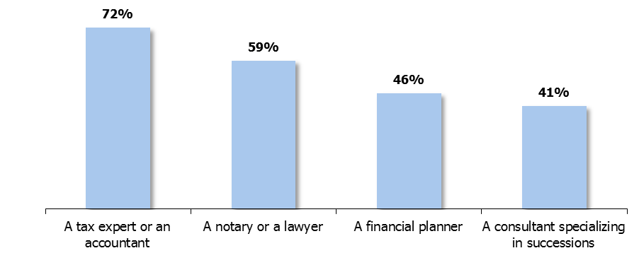
8. Owner succession
Figure 23 – Have contacted or plan on contacting the following resources regarding succession planning (n=46)
Most owners who plan on leaving their company in the next five years and have started thinking about succession have contacted or plan on contacting a tax attorney or accountant (72%), or a notary or lawyer (59%). Less than half have contacted or plan on contacting a financial planner (46%) or a succession specialist (41%).
37

Slide 38
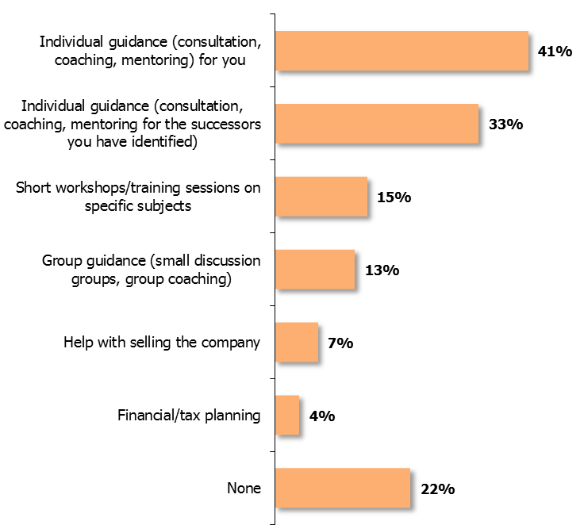
8. Owner succession
Figure 24 – Desired support with regards to succession planning (n=46)
Subjects/themes of these workshops or training sessions (n=7) | %
Financial aspect/financial planning/taxation | 43%
Other* | 72%
Did not know/refused to answer | 29%
* Verbatim of answers: “human resources”; “transfer”; “how to find a qualified notary or attorney”; “choosing a good successor” (avoid including emotions)”; “coaching with regards to managing the sale (how to take all the steps)”
Respondents would most like to receive individual coaching for themselves (41%) or their successors (33%).
Those who would like to receive training are most interested in learning about financial planning and taxation.
38

Slide 39
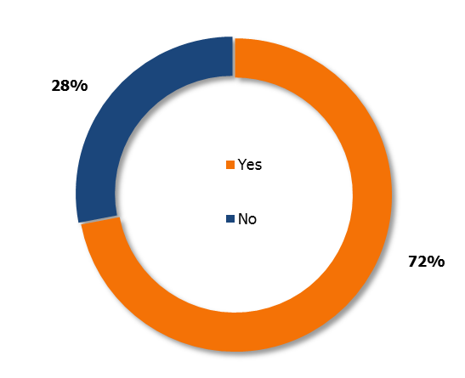
8. Owner succession
Figure 25 – Knowledge of the company’s market value (n=46)
Table 19 – Basis for the market value of a company (n=33)
Market value | 76%
Book value | 52%
The amount needed for your retirement | 6%
Other | 9%
Close to three-quarters of owners who plan on leaving their company in the next five years and have started thinking about succession claim to know its market value. This value is mostly based on the market value (76%) or the book value (52%).
39

Slide 40
Appendix – Verbatim accounts
Table 15 – Reasons why recruiting the employees that were hired was difficult
Table 16 – Reasons why recruiting the employees that were hired was easy
Verbatims of “other” answers (n=4)
“Competition from outside the region.”
“Expensive specialized training for the future employee.”
“Because we have a subsidy from Emploi-Québec and their requirements really hamstring us with regards to labour.”
“There is no place where people can live. Everybody goes to the city. Housing is difficult.”
  Verbatims of “other” answers (n=5)
“We were the creators.”
“It depends on the type of labour, non-specialized that requires mobility, but nothing complicated.”
“Depending on his availability because his schedule doesn’t always work with mine.”
“Recruiting the last employee was easy because he lives near Bouchette and came here for an internship.”
“No one is interested in seasonal or weekend work.”
Table 18 – Concerns or challenges with regards to succession planning
Verbatims of “other” answers (n=4)
“Recruiting (e.g.: an experienced butcher would be appreciated)”
“Because of the size of the store/the factors to contend with, and just working in there is difficult. Paperwork takes up a lot of energy.”
“It’s vital to have strong physical and management skills, to be knowledgeable and more vigilant and to know the issues.”
“That both parties (assigner and successor) be totally satisfied.”
40

